Slide 1

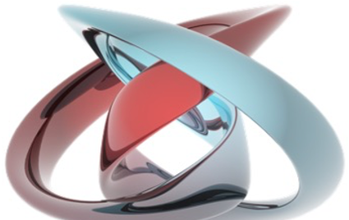
mesoscopic and nanoscale physcis
Laboratory of Quantum Physics: Topology and Correlations
Quantum transport in Mesoscopic systems
(PHYS-462)
Mitali Banerjee (LQP)
mesoscopic physics deals with the physics of small objects consisting of a collection of atoms
nanometer scale
Length scale
atoms
molecules & clusters
electron mean free path
bulk materials
micro
meso
macro
Goldhaber-Gordon et al., Nature 391, 156 (1998)
Cronenwett et al., Science 281, 540 (1998)

Slide 2
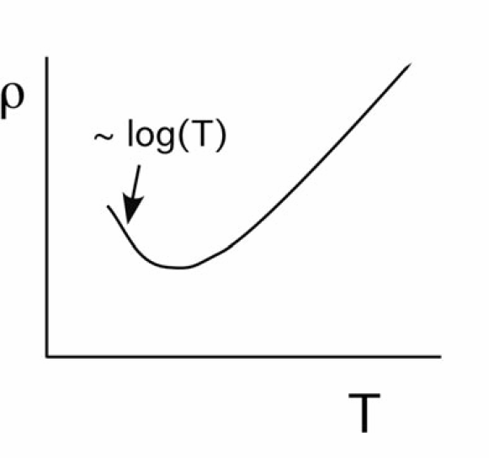

Kondo Effect in Metals
1930s experiments:
1960s: (exp) related to magnetic impurities
theoretical explanation by Jun Kondo spin-fip scattering on mag. impurities
lattice
phonons

Slide 3
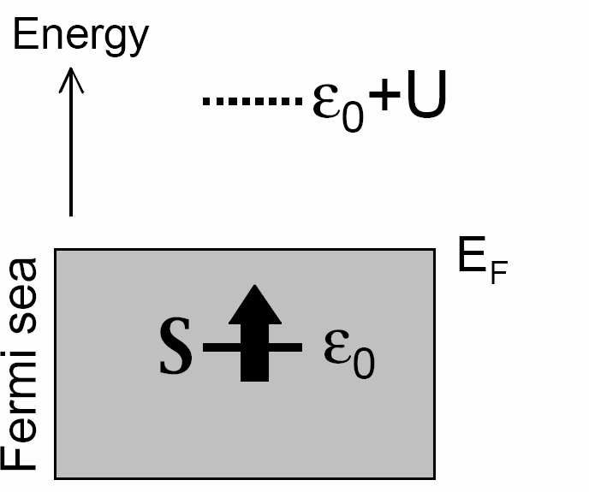
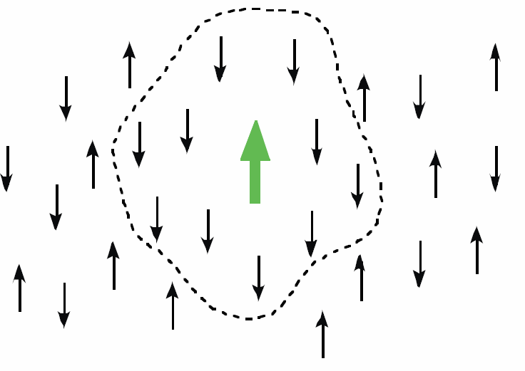
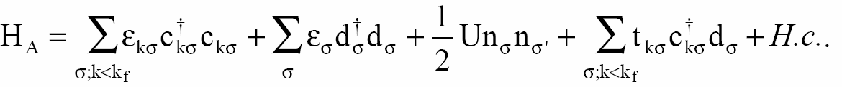
Kondo Effect in Metals: Model
new energy scale: Kondo temperature T_{K} formation of spin-singlet screening cloud
cloud: more effective scatterer increase in resistance
Anderson Hamiltonian
free electrons
localized electrons
on site charging
coupling between localized and free ele.

Slide 4
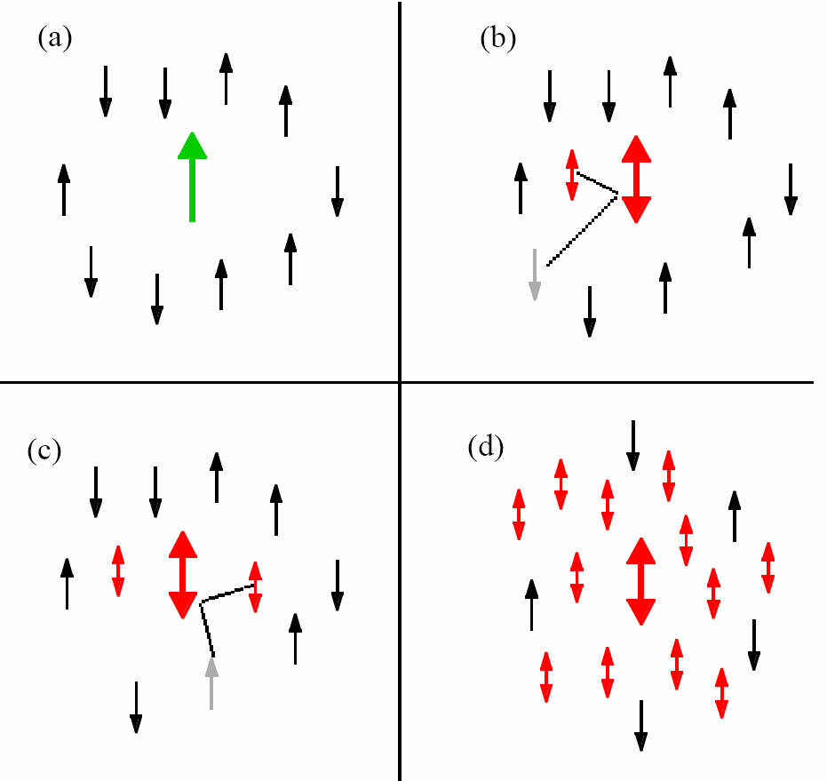
Kondo Effect in Metals: spin flip scattering
each scattering event engangles impurity with conduction electron
singlet cloud formation temperature scale T_{K}

Slide 5
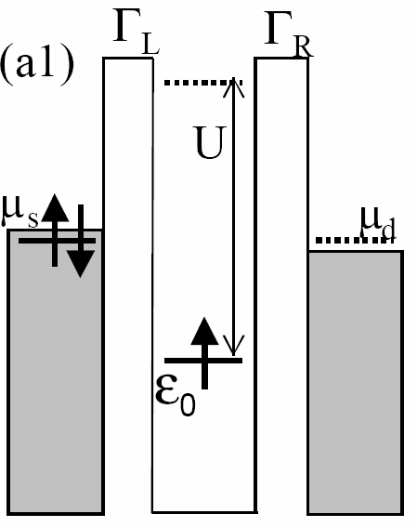
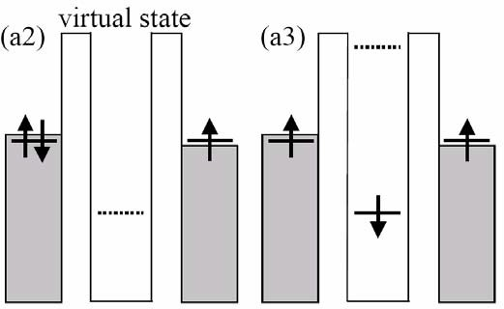
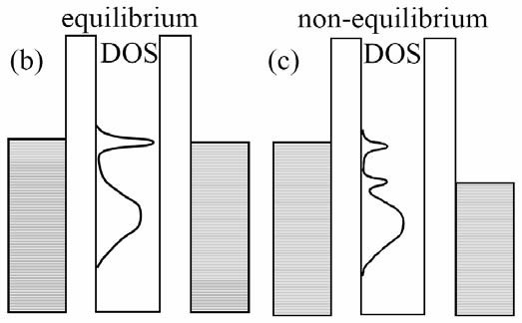


Kondo Effect in Quantum Dots
spin-flip cotunneling (elastic)
for T<T_{K} : DOS at µ_{S,D} enhanced zero bias conductance!!
unpaired spin
for T >> T_{K} DOS peak suppressed
dots: parameters tunable SINGLE impurity
Kondo physics will be visible if kT_{K}(<Γ)
Notes:
The Kondo effect can be pictured as a narrow resonance in the density-of-states (DOS) of the dot at the Fermi energies of the leads, μ_{L} = μ_{R}. The lower energy bump in the DOS is the broadened single-particle state ɛ₀. A source-drain voltage Vresults in the difference eV = μ_{L} − μ_{R}. For finite V, the DOS peak splits in two; one peak is located at each chemical potential.

Slide 6
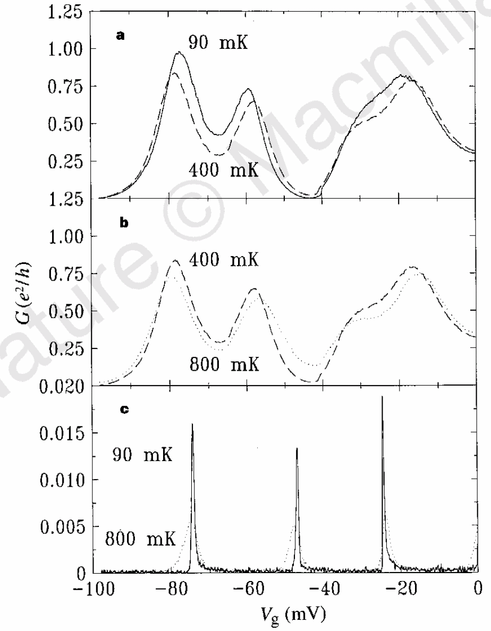
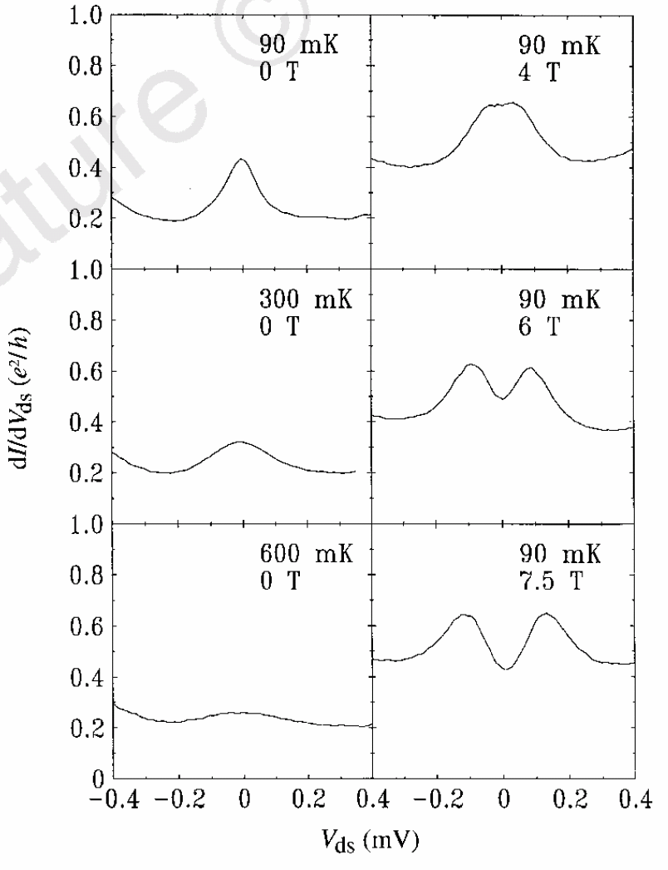
Kondo Effect in Quantum Dots: Experiment
larger Γ and hence larger T_{K}
Goldhaber-Gordon et al., Nature 391, 156 (1998)

Slide 7
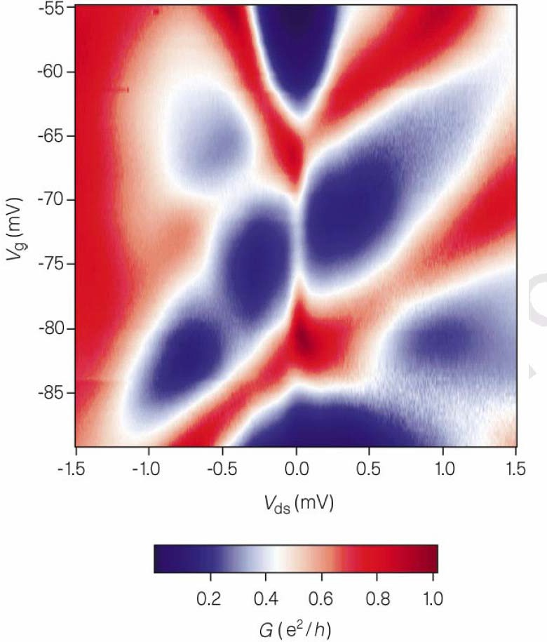
Kondo Effect in Quantum Dots: Experiments
Differential conductance on a colour scale as a function of both V_{g} and V_{ds}.
The white vertical line between the two maxima indicates that there is a zero-
bias peak for odd N only.
Goldhaber-Gordon et al., Nature 391, 156 (1998)

Slide 8
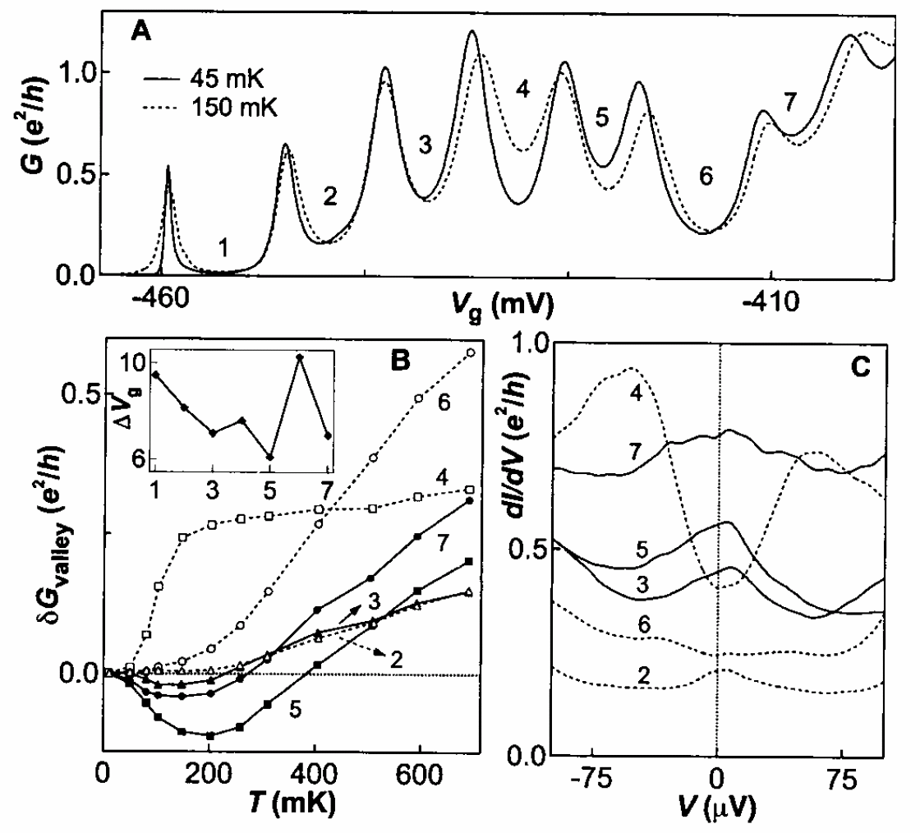
Kondo Effect in Quantum Dots: Experiments
Cronenwett et al., Science 281, 540 (1998)
Notes:
The parity of the electron number in the valleys is indicated by an odd or even number. From left to right, the CB peaks become broader (that is, Γ is increasing) because the tunnel barrier induced by gates 1 and 2 decreases when increasing the voltage on gate 1. Increasing T from 45 to 150 mK increases the conductance of the even-numbered valleys but decreases the conductance of valleys 3, 5, and 7.

Slide 9
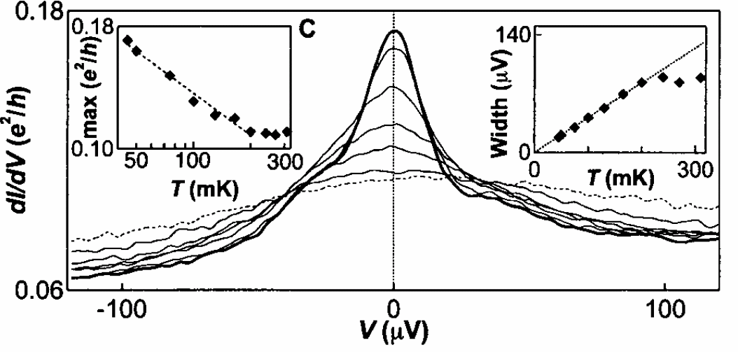
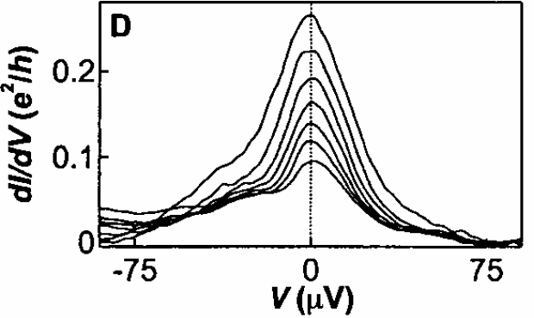
Kondo Effect in Quantum Dots: Experiments
gate voltages into odd valley
45 mK for different gate voltages
Cronenwett et al., Science 281, 540 (1998)

Slide 10
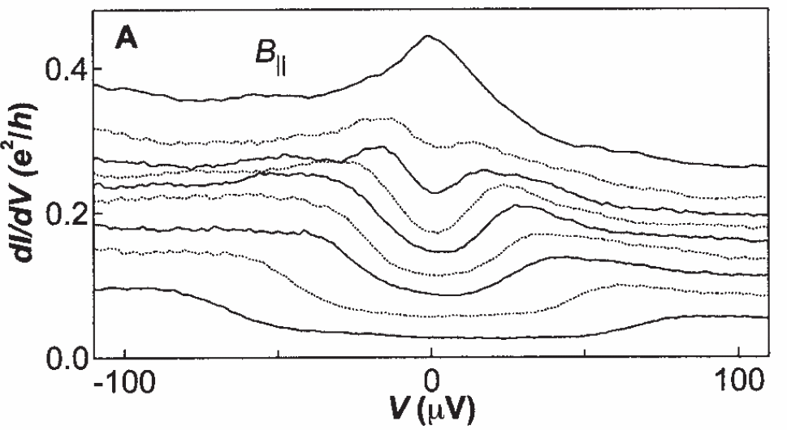
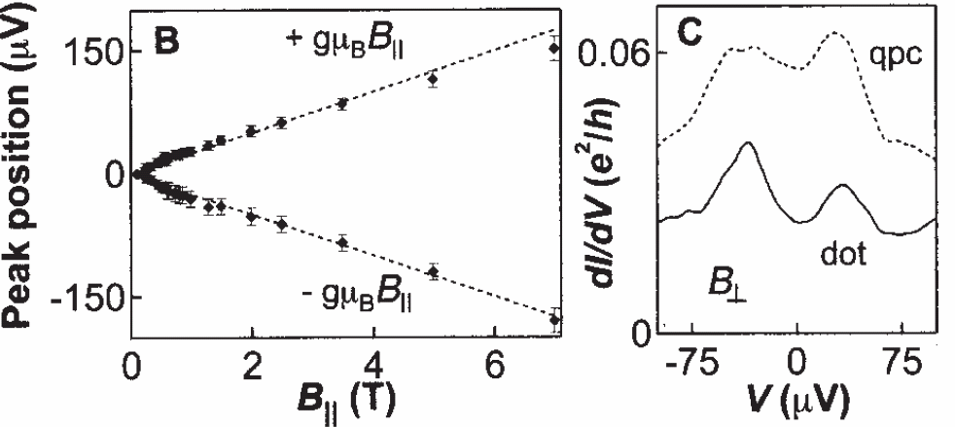
Kondo Effect in Quantum Dots: Experiments
The correct splitting of the dI/dV peak with magnetic field is considered as the most distinct sign of Kondo physics
Cronenwett et al., Science 281, 540 (1998)

Slide 11
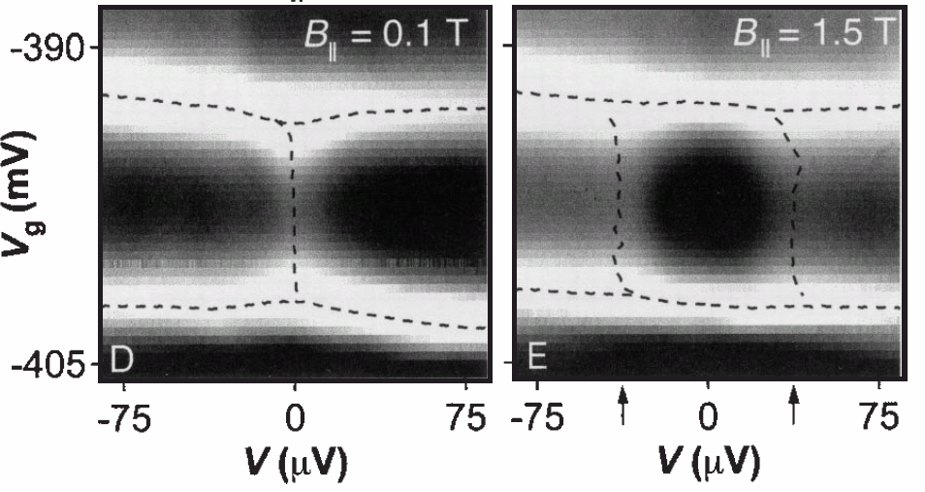
Kondo Effect in Quantum Dots: Experiments
Experiment
Theory
The Kondo temperature can be tuned using a gate voltage as a single-particle energy state nears the Fermi energy.
Cronenwett et al., Science 281, 540 (1998)

